Slide 1
Synchronization of coupled oscillators
By Djin, Juliana & Kevin

Slide 2
Oscillations
The repetitive variation of a measure around a central value over time
A very common type of motion found in all type of systems. Examples include:
mass on a spring
Pendulum
AC current
Predator-prey dynamics
etc
With the solution being a linear combination of sine and cosine waves:
COUPLED OSCILLATORS: Two or more oscillating systems connected in a way they can exchange energy
By Svjo - Own work, CC BY-SA 3.0
Notes:
Coupled oscillators: The exchange is not necessarily mechanic, it can be communication in the form of light (fireflies) or sound (clapping or crickets chirping in unison)

Slide 3


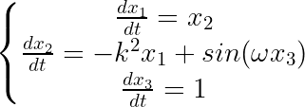


Dynamical systems perspective
What we learned in this class
Our first example of Dynamical Systems
Lienard System
Van Der Pol Oscillator
Harmonic Oscillator
-Autonomous
Forced Harmonic Oscillator
-Higher Dimension=Autonomous

Slide 4
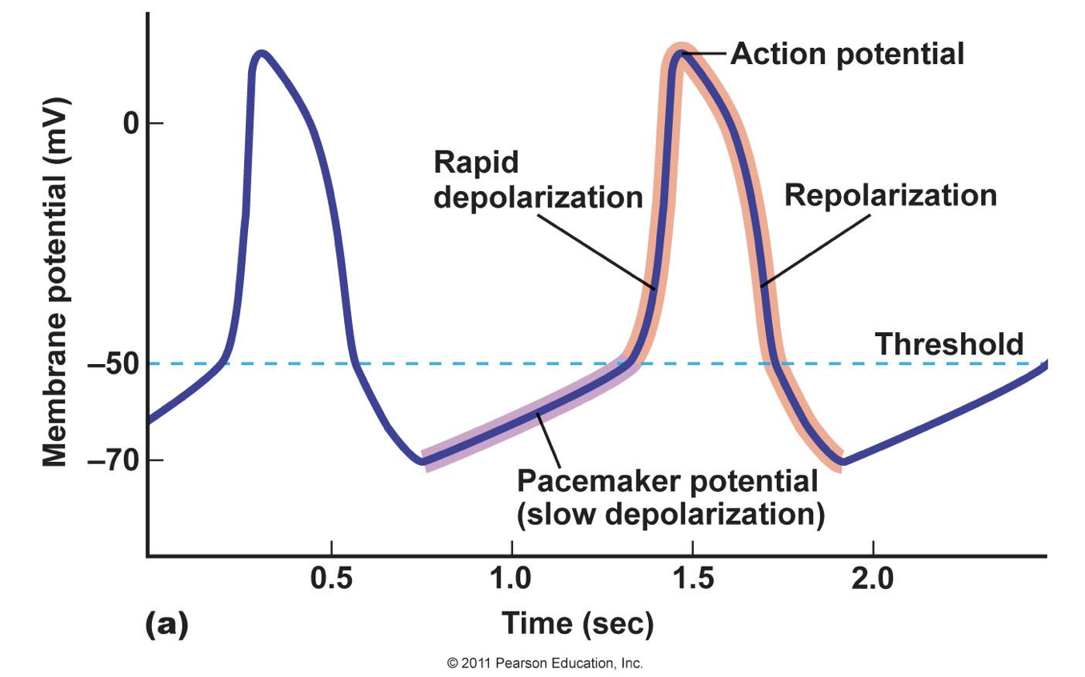
Spontaneous synchronization
Examples
Pacemaker cells
Millenium bridge in london
Fireflies
Notes:
Talking points: In the first video fireflies synchronize with led lights.
In the second metronomes synchronize with each other

Slide 5

Spontaneous synchronization
Notes:
Talking points: In the first video fireflies synchronize with led lights.
In the second metronomes synchronize with each other

Slide 6
Spontaneous synchronization
Examples
Pacemaker cells
Millenium bridge in london
Fireflies
Metronomes
Notes:
Talking points: In the first video fireflies synchronize with led lights.
In the second metronomes synchronize with each other

Slide 7
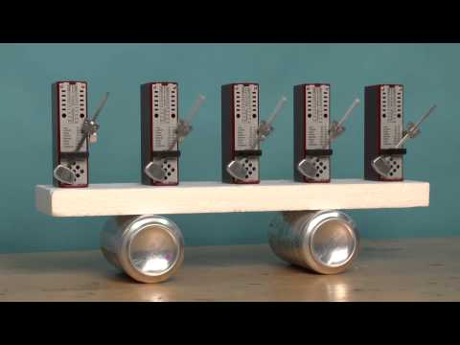
Spontaneous synchronization
Notes:
Talking points: In the first video fireflies synchronize with led lights.
In the second metronomes synchronize with each other

Slide 8
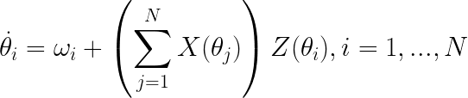
Background
Wiener (1958) : Recognizes how widespread collective synchronization was in the natural world.
Winfree (1967) reformulated the problem, assuming:
A large population of interacting nearly identical oscillators.
The coupling was weak.
Two different timescales:
Fast: oscillators relax to their limit cycle and can be characterized by their phase
Slow: the phases evolve as a consequence of coupling.
Change of phase in time
Natural frequency
Influence of others
Sensitivity to others
Notes:
Talking Points:
Discuss Wieners postulation that there are oscillating cells in the brain with a gaussian distribution of natural frequencies that interact and create the power spectrum of apha waves--he sees it as an example of spontaneous synchronization
Where theta i is the phase of oscillator i and omega i is it’s natural frequency
Given N oscillators the oscillator i is influenced by two forces.
The phase dependent influence of its neighbors X(theta_j)
And the response of oscillator i depending on its own phase Z(theta_)i

Slide 9


Kuramoto model
A new foundation to Winfree’s intuition
For any system of weakly coupled, nearly identical limit cycle oscillators, long term dynamics are described by:
Winfree’s model
But these equations are still too difficult to analyze. Another simplification:
Equally weighted, all to all, purely sinusoidal coupling
KURAMOTO MODEL (1975)
Notes:
Long term dynamics are given by these phase equations, where theta dot represents how fast the oscillator moves around the circle

Slide 10
Kuramoto model: interpretation
The blue dot encourages the green dot to speed up
The purple dot encourages the green dot to slow down
How to represent the behavior of a large set of oscillators?
introduce a parameter to describe the system macroscopically: the order parameter.

Slide 11



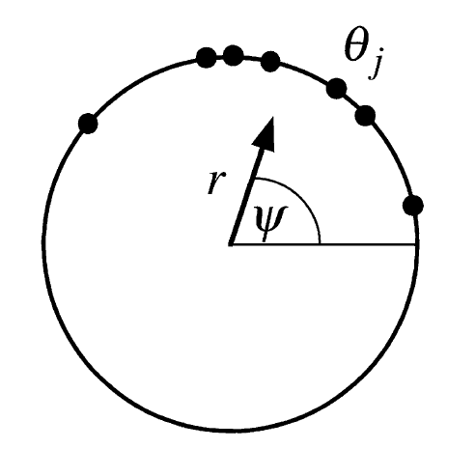

Kuramoto model: order parameter
Order parameter:
measures phase coherence
average phase of the system
Rewrite Kuramoto model in terms of order parameter by multiplying both sides of the definition by
Equating imaginary parts:
KURAMOTO MODEL:
S.H.Strogatz/Physica D 143 (2000) 1-20

Slide 12
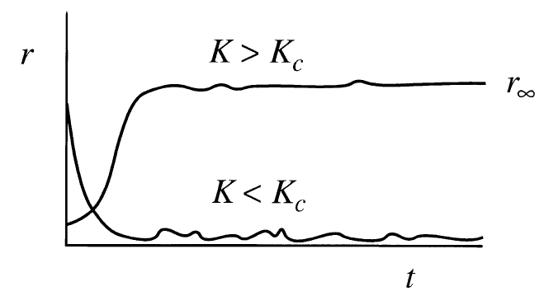
Kuramoto model: intuition
A new way to think about this system:
Oscillators interact through the mean field quantities.
The individual phase of each oscillator is pulled to the mean phase of the system.
The coupling is proportional to the coherence of the group.
How does the order parameter evolve with time? Numerical simulations show:
For all K under a certain threshold oscillators act as if uncoupled.
For K above that threshold, r(t) grows exponentially until it saturates at some level (although fluctuations continue)
An elegant model, but a couple of unresolved problems

Slide 13
Numerical examples

Slide 14
Numerical examples

Slide 15
Applications: neuroscience

Slide 16
Applications: ---

Slide 17
References

